Slide 1
Our Mission and Vision
At
St. Joseph’s Catholic
Primary School

Slide 2
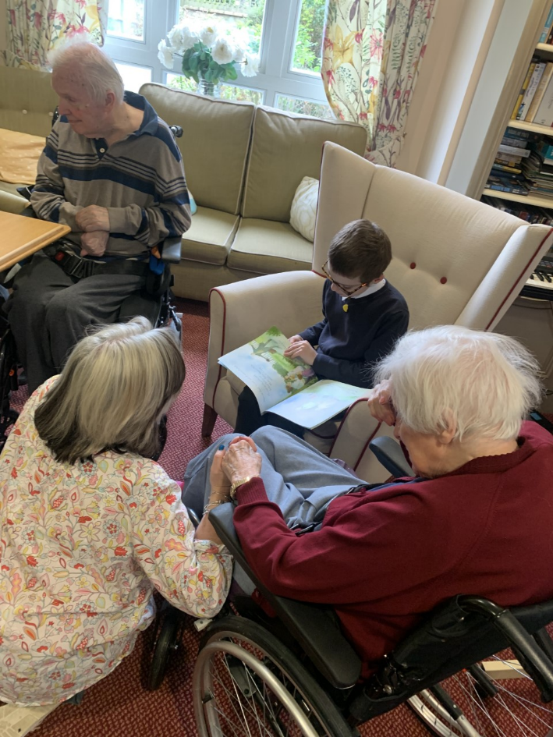
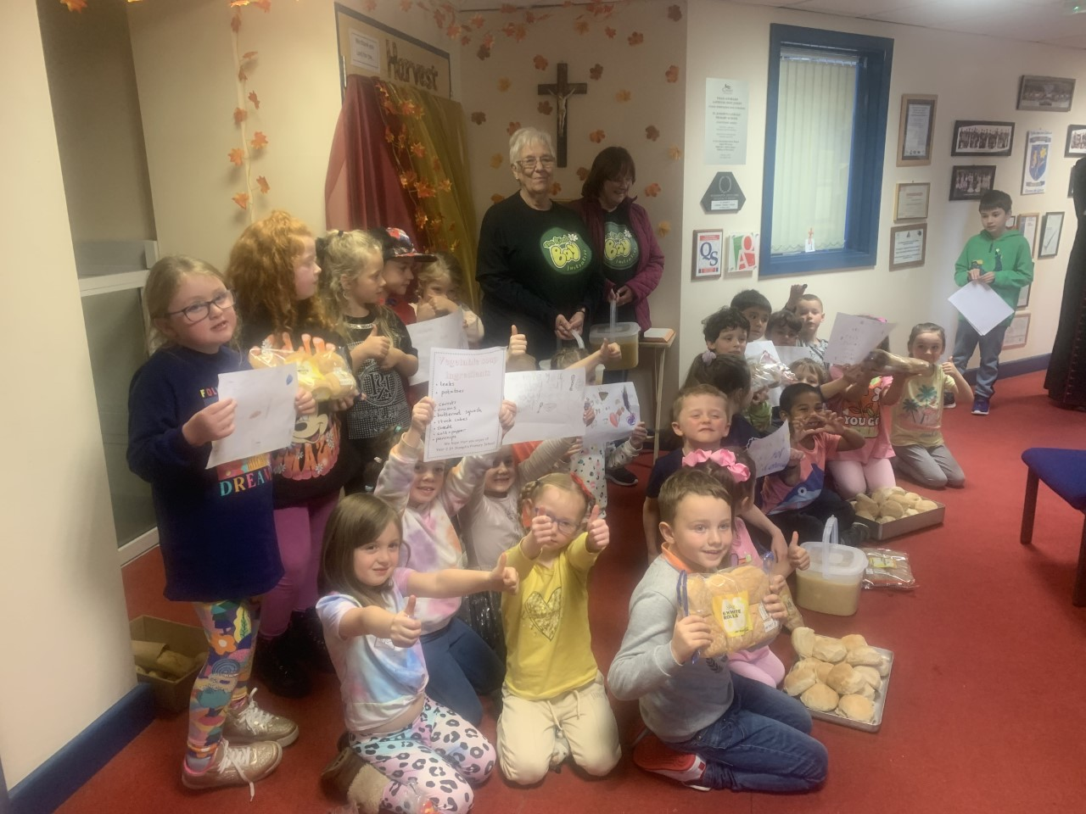
Our mission is to provide a welcoming Catholic, happy, safe, inclusive and supportive learning environment in which everyone is equal, valued and respected.
A community where children, families and staff grow and make maximum use of their God given talents. In forming a partnership with parents and carers we strive to be at the centre of the local community.

Slide 3
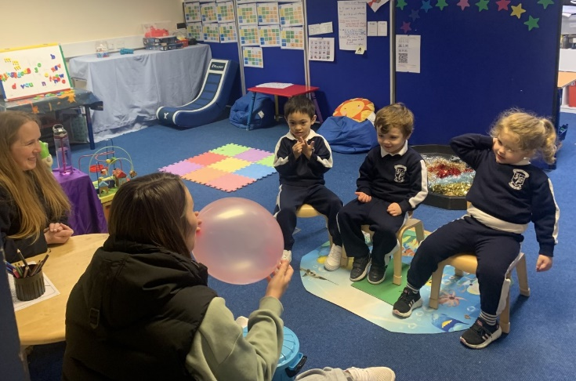
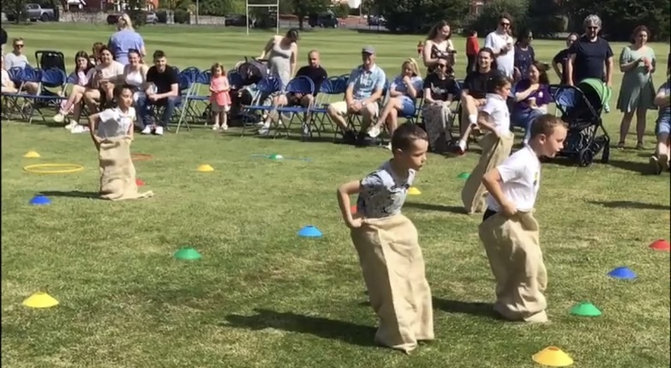
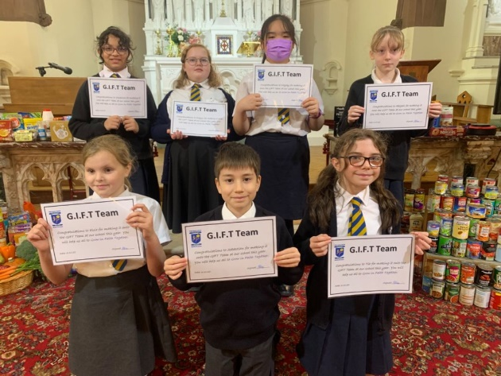
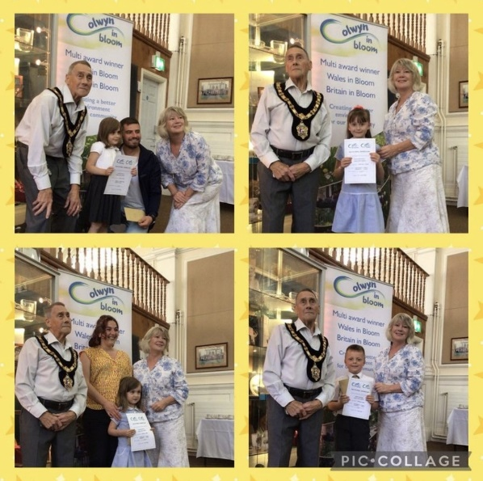
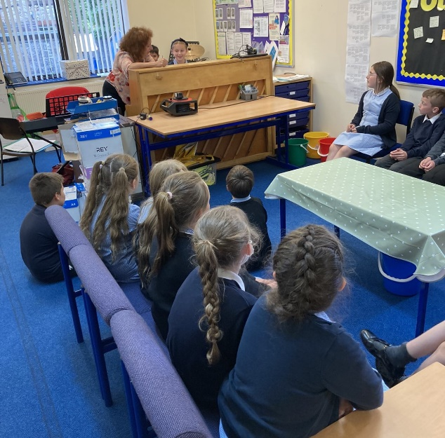
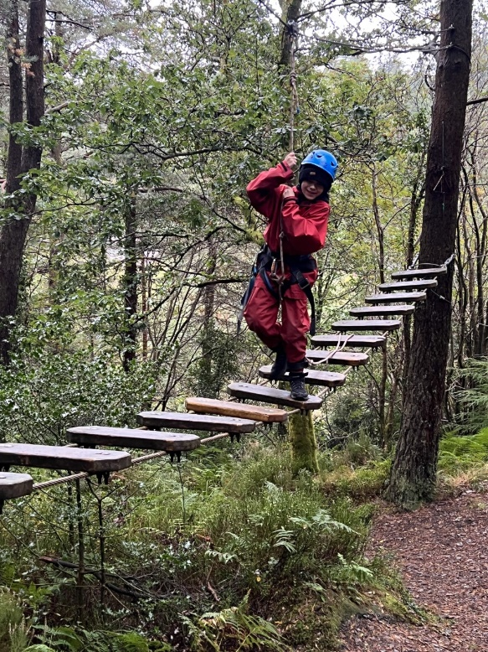
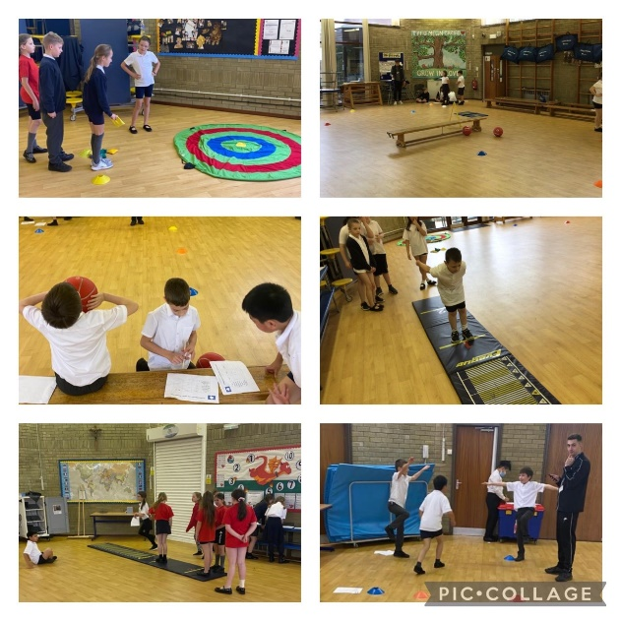
Our goal is to support and nurture in order to develop well rounded, confident and responsible individuals who aspire to achieve their full potential.
Our nurture room to further support pupils in a stimulating environment.
Whole school sporting competitions in our house teams.
The GIFT Team leading worship opportunities in our school.
Taking part in community competitions, like Colwyn in Bloom.
Sharing and celebrating our musical talents.
Residential trips to build confidence and develop teambuilding.
Transition to high school opportunities from Y4 upwards.

Slide 4
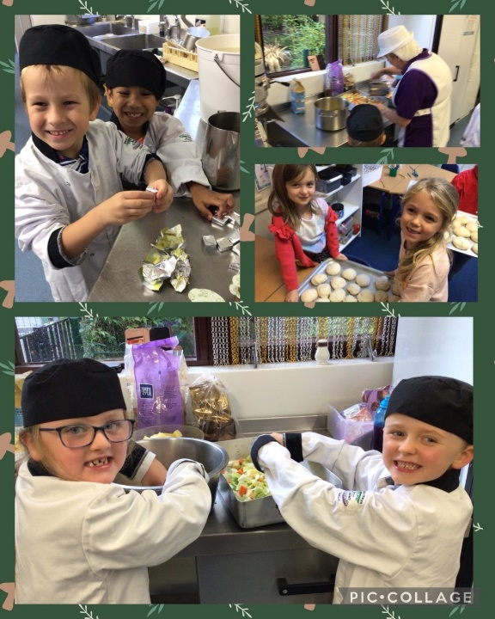
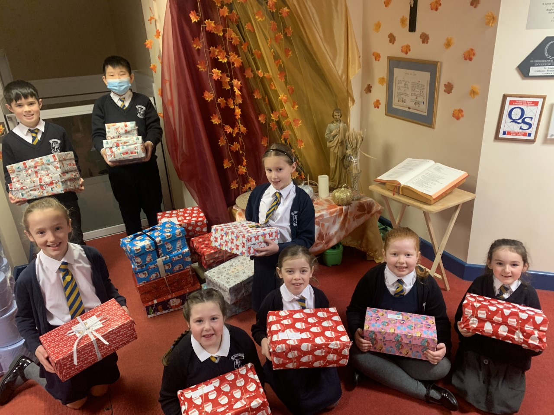
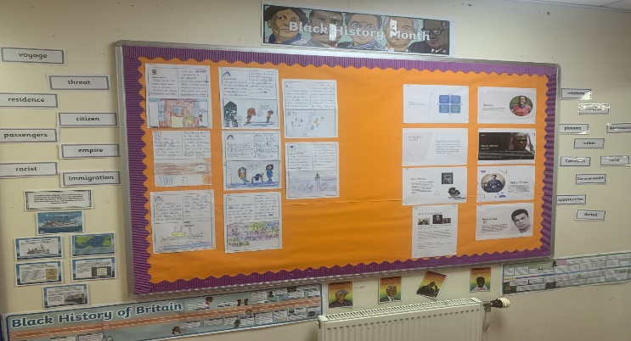
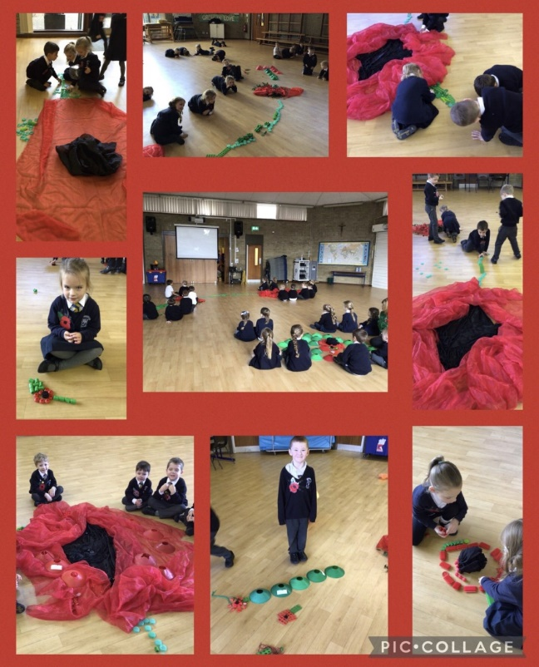
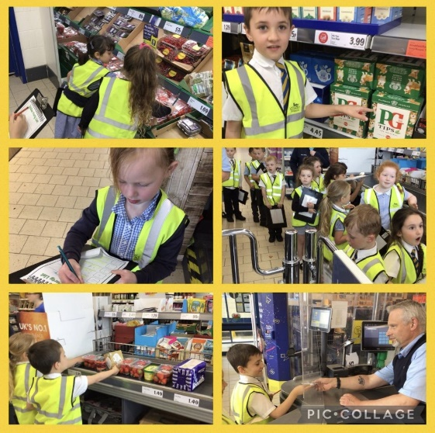
Our vision for each child is to develop a curiosity of learning, discover their interests and help them grow in their love of learning; to be responsible citizens and to make a difference. We aim to equip our pupils with the skills and mind set to thrive and take on the world.
Supporting charities like T4U Christmas Shoebox.
Learning out in the community, making connections with local businesses.
Real life experiences make enthusiastic learners.
Celebrating topical events such as Black History Month.
Learning in creative ways.
Staff offering a wide range of extra curricular clubs to spark interest..

Slide 5
Healthy, Confident Individuals
who are ready to lead fulfilling lives as valued members of society.
Ambitious, capable learners
who are ready to learn throughout their lives.
Ethical, informed citizens
who are ready to be citizens of wales and the world.
Enterprising, creative contributors
who are ready to play a full part in life and work.
The Four Purposes
Of the Curriculum
For Wales

Slide 6
Our Values
A St Joseph’s, the Gospel Values are embedded across the school and permeate everything we do. We focus on eight core Gospel Values.
We strive to live out our motto – Grow in Love. Jesus taught us the new commandment was to ‘love one another’ and we believe that by living out these Gospel Values in our everyday lives, they will help us to Grow in Love together.
Together with our vision and mission statements, our values help form our collective identity.
Respect
Forgiveness
Honesty
Love
Faith
Fairness
Serving
Unity

Slide 7
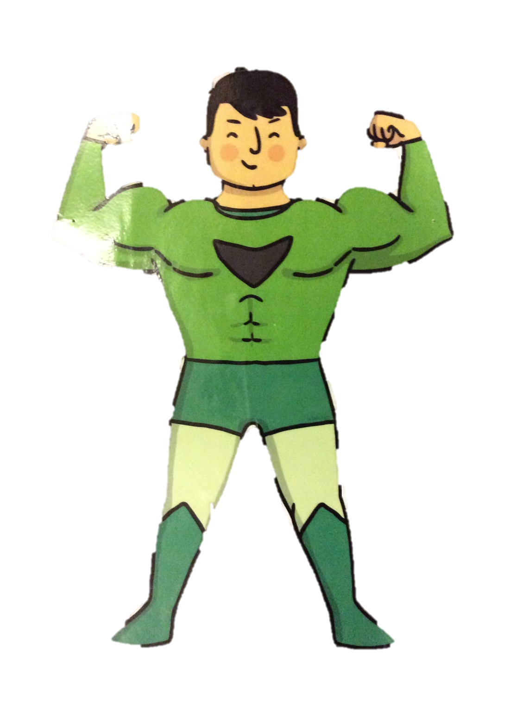
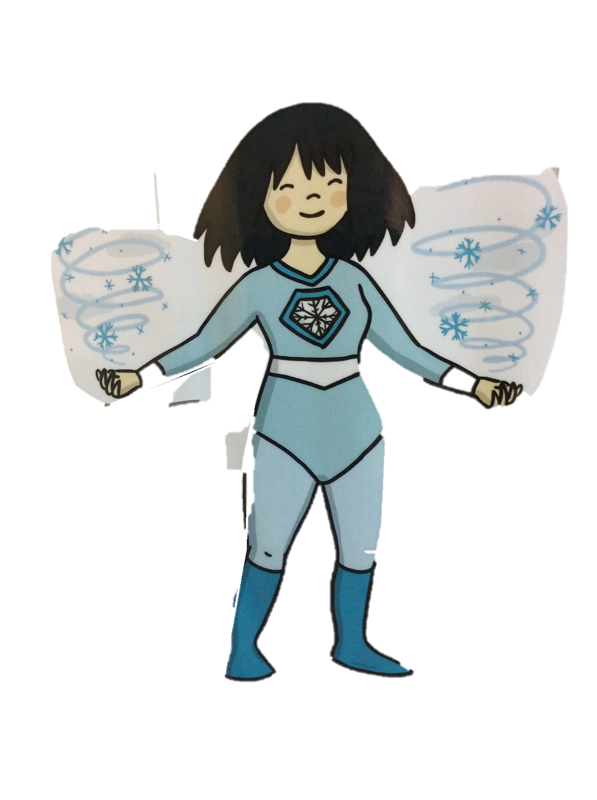
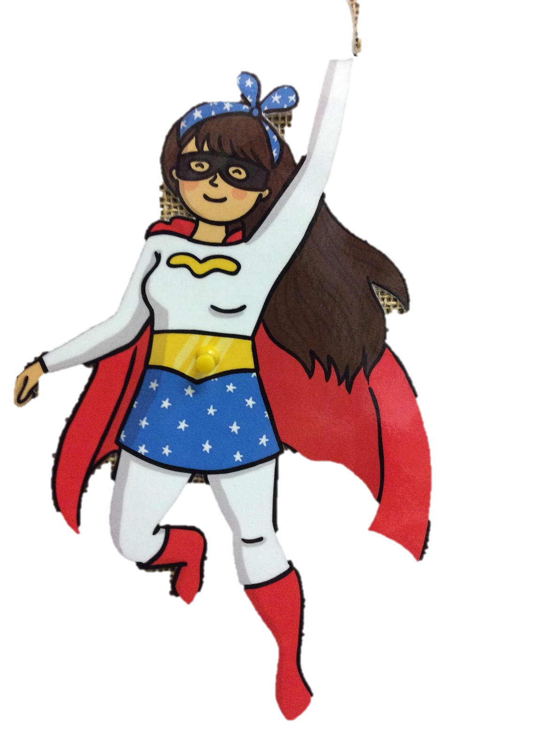
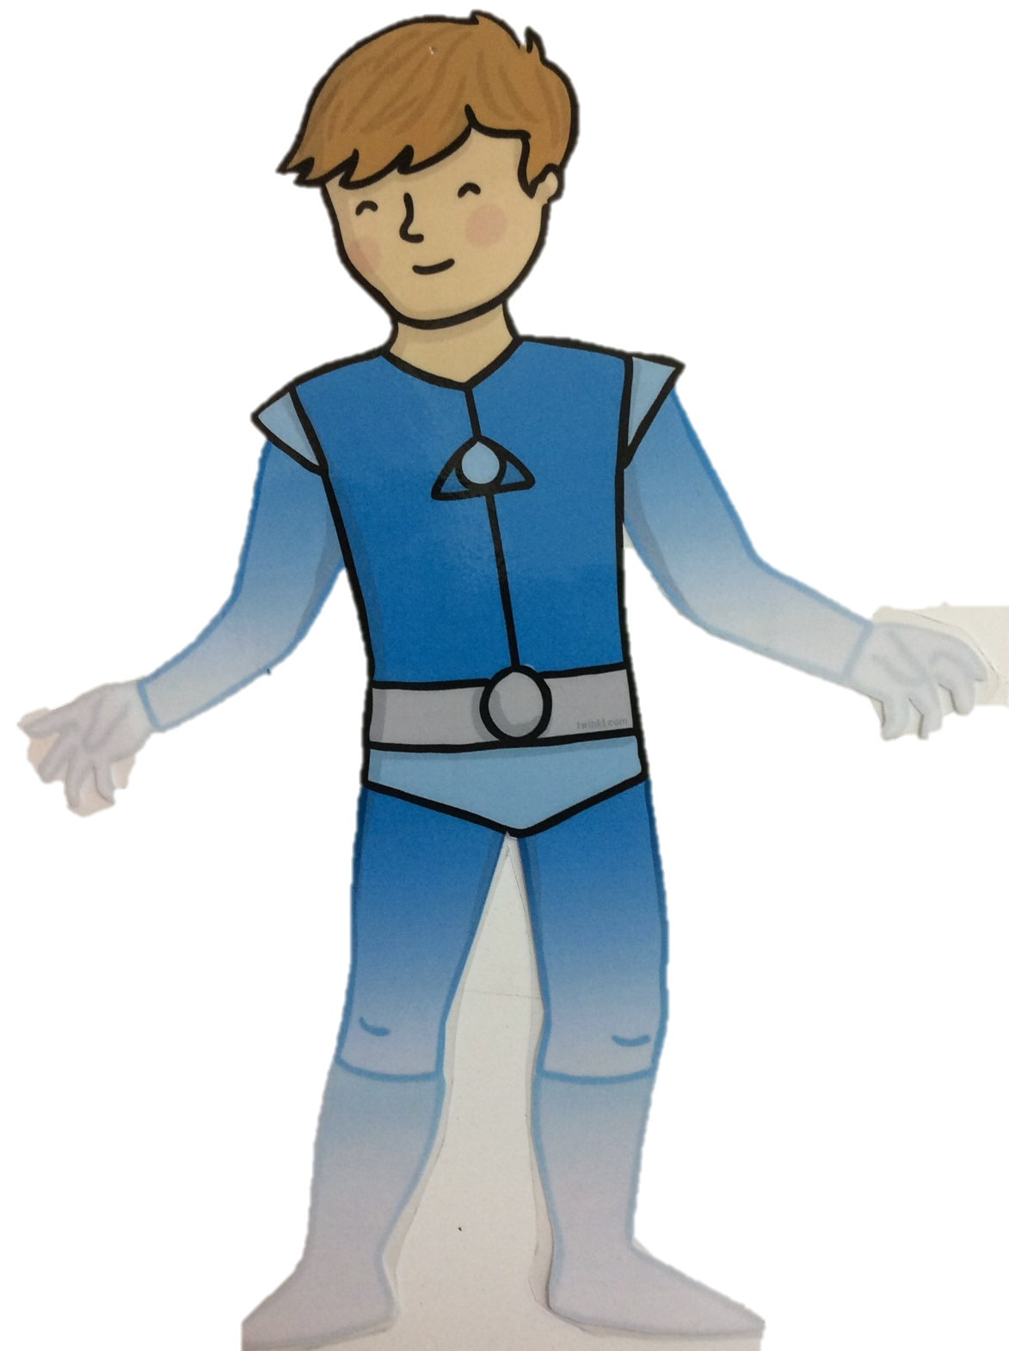
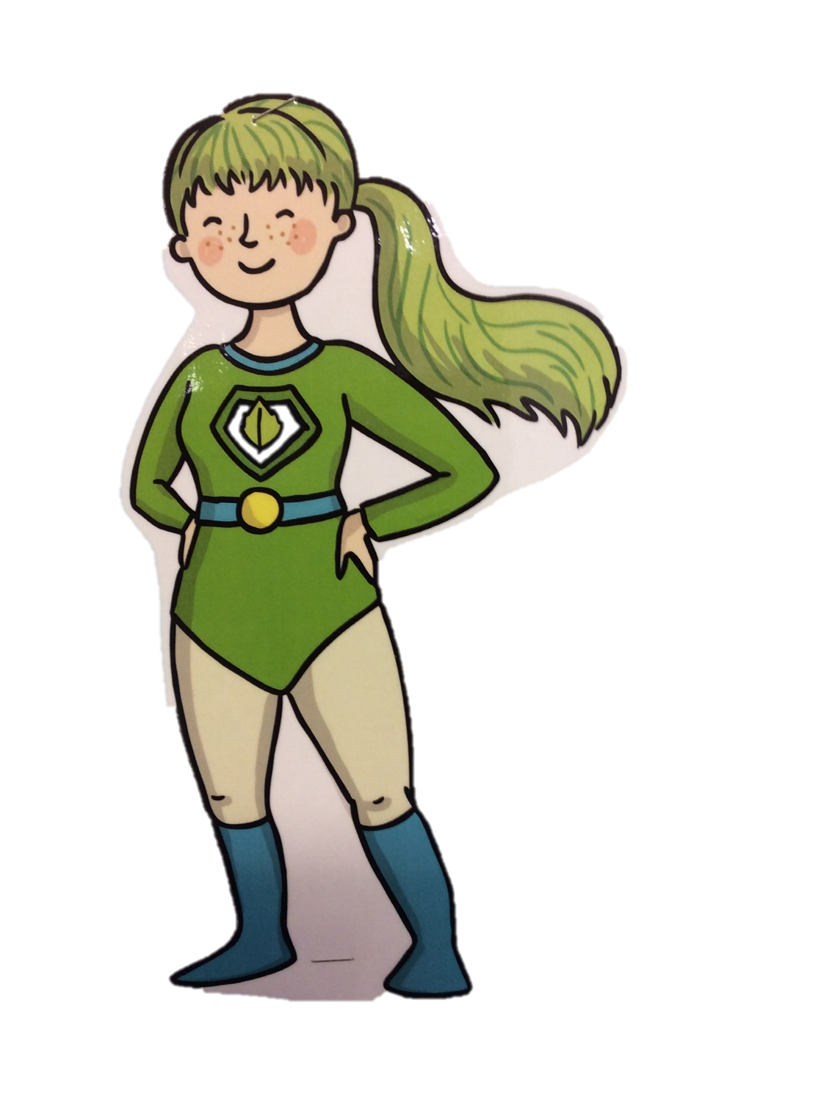
Learning Powers
Here in St. Joseph’s we follow the Shirley Clarke approach, encouraging a positive mind-set to our academic studies. The Learning Powers are promoted in each class and the children use them to help motivate them when completing tasks and challenges.
Don’t Give Up!
Daliwch ati!
Concentrate
Canolbwyntiwch
Use Your
Imagination
Defnyddiwch eich dychymyg
Have A Go!
Trïwch!
Be Co-operative
Gweithiwch efo’ch gilydd
Enjoy Learning!
Mwynhewch ddysgu!
Be Curious
Byddwch yn chwilfrydig
Keep Improving
Daliwch ati i wella

Slide 8
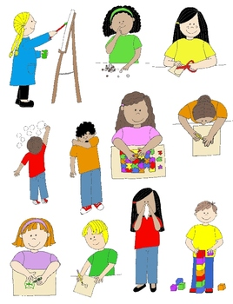
Your child will be encouraged to develop the following skills….
Problem Solving
Independent Thinking
Self-Belief
Environmental Awareness
Academic Success
Resilience
Kindness and Respect
Confidence
Musical and Artistic Talents
Sporting Ability

Slide 9
They will be offered the following experiences…..
A strong sense of belonging to our family. | An appreciation of diversity and equality. | An understanding of our local area.
Friendships | Trips out | A love of Welsh culture and language.
Prayer, Faith, Sacraments and the importance of Church | Learning in and about the natural world. | Variety of after school activities and sporting experiences.

